Slide 1
DATA SCIENCE
10 WEEK PART TIME COURSE
Week 6 - Decision Trees

Slide 2
Before we get started
Download GraphViz and PyDot
pip install pydot
pip install pydot2
http://graphviz.org/Download..php
Yes, really.

Slide 3
AGENDA
Why this is the most awesome and interesting lesson
What are decision trees?
How decision trees work
Visual example on Titanic dataset
Lab
Talks
Discussion

Slide 4
Why this lesson will change your life for the better* [*] YMMV
DATA SCIENCE PART TIME COURSE

Slide 5
Decision trees
Save lives
http://www.ncbi.nlm.nih.gov/pubmed/25160603
Make data scientists look awesome
“If you follow this simple diagram, we make $$$$$”
Can be used for some really smart stuff…

Slide 6
DECISION TREES
DATA SCIENCE PART TIME COURSE

Slide 7



Record store example
Beard
Customer facial hair
None
> 50
Customer age
<=50

Slide 8
Yes, but how to make them?
Perfect decision trees are NP-complete
(Computer scientist speak for “good luck with that”)
Some techniques exist for creating quite good ones
Danger of over-fitting
Scans for a feature to split on that results in the greatest separation between classes in the resulting nodes.
Non-linear
Greedy process
Splits within splits

Slide 9
Interactive Immersive Experience Phone case purchase data cards Blu-tak
DATA SCIENCE PART TIME COURSE

Slide 10
Using sklearn’s Decision Tree API
import sklearn.tree
DF = …
Trying_to_predict = DF[[‘target_column’]]
Source_data = DF[[‘column1’,’column2’,…]]
dtc = sklearn.tree.DecisionTreeClassifier(criterion='gini’,
max_depth=1)
dtc.fit(Source_data,Trying_to_predict)
Predictions = dtc.predict(Source_data)

Slide 11
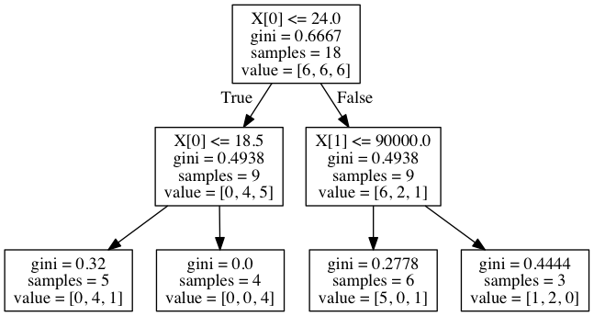
Making a quick diagram
try:
from StringIO import StringIO
except ImportError:
from io import StringIO
import sklearn.tree
import IPython.display
import pydot
File_obj = StringIO()
sklearn.tree.export_graphviz(dtc, out_file=File_obj)
Graph = pydot.graph_from_dot_data(File_obj.getvalue())
IPython.display.Image(Graph[0].create_png())

Slide 12
Interactive Immersive Experience Phone case purchase data cards Blu-tak
DATA SCIENCE PART TIME COURSE

Slide 13
Repeat until satisfied
Increase max_depth
Try ‘entropy’ instead of ‘gini’ (matters less than 2% of the time)
Gini | Entropy (Information Gain)
Usually finds the largest class | Finds groups of classes that make ~50%
Minimise misclassification | Exploratory analysis
Continuous attributes | Attributes are classes

Slide 14
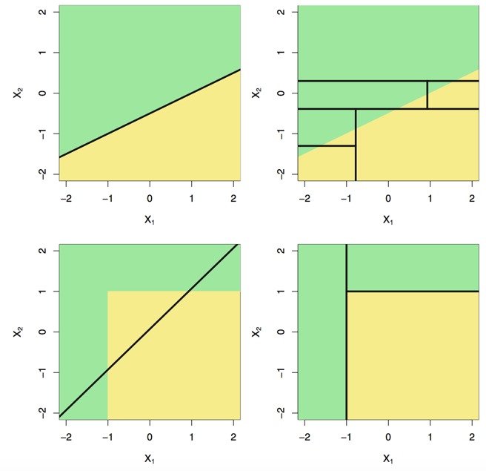
DECISION TREES - HOW IT WORKS
Linear decision boundary
Non-linear decision boundary

Slide 15
Simple ways to measure what it did
Gini importance
Which parameters mattered?
dtc.feature_importances_

Slide 16
DECISION TREES - SHORTCOMINGS
Prone to overfitting.
Predictive power is lower in comparison to many other modern techniques.

Slide 17
LAB
DATA SCIENCE PART TIME COURSE

